Slide 1

Note: The data and information in this document is reflective of a hypothetical situation and client. This document is to be used for KPMG Virtual Internship purposes only.
Sprocket Central Pty Ltd
Data analytics approach
[Data Analytics Department] - [Engagement Manager], [Senior Consultant], [Junior Consultant: Md. Sakib Bin Alam]

Slide 2
Note: The data and information in this document is reflective of a hypothetical situation and client. This document is to be used for KPMG Virtual Internship purposes only.
Agenda
Introduction
Data Exploration
Model Development
Interpretation

Slide 3
Note: The data and information in this document is reflective of a hypothetical situation and client. This document is to be used for KPMG Virtual Internship purposes only.
Introduction
Existing customer analysis to predict trends and recommendation for new customers to drive the most value for the organisation.
Numerous plots have been generated in order to explore the relations between different features, aiming to enhance the value of the company. The chosen features for analysis are as listed below:
- Age, Gender
- Job industry Category
- Wealth segment
- Bike purchased
- State
- Profit

Slide 4
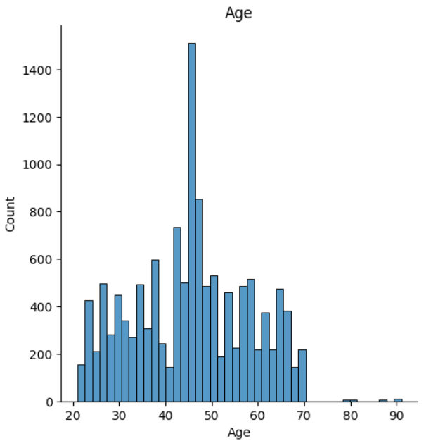
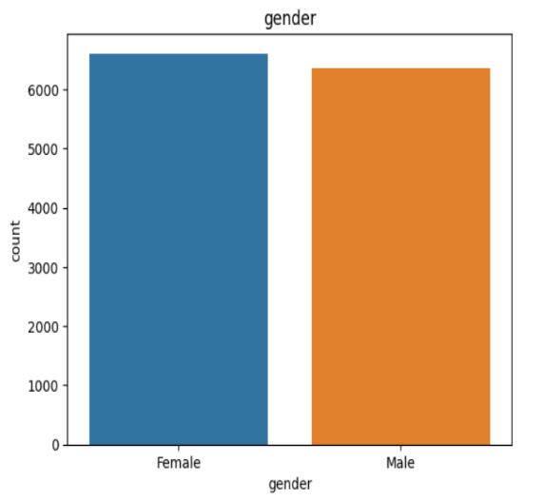
Note: The data and information in this document is reflective of a hypothetical situation and client. This document is to be used for KPMG Virtual Internship purposes only.
Data Exploration
Age & Gender
Client’s have age range from 20 to 70, where most of the clients’ age is between 41 to 45.
In terms of gender there is no significant difference between male and female.

Slide 5
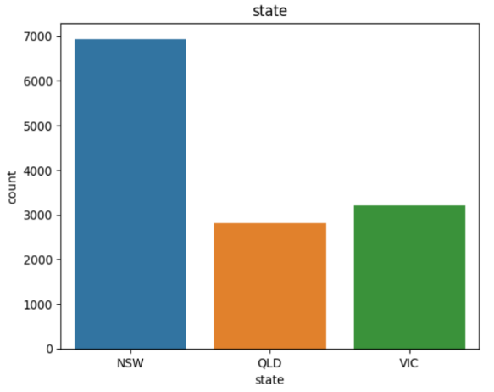
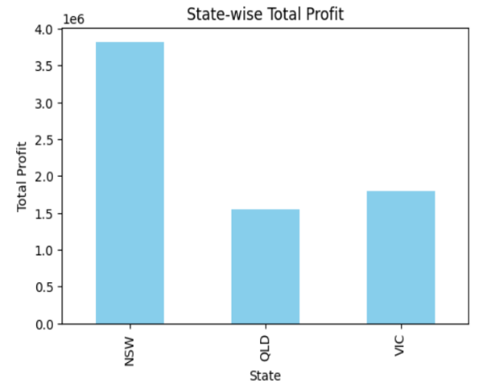
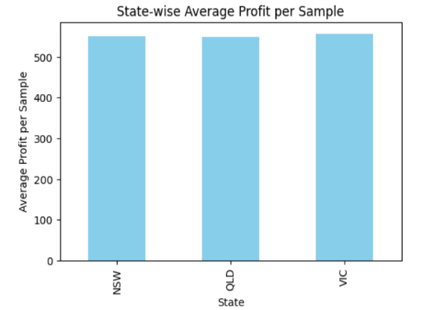
Note: The data and information in this document is reflective of a hypothetical situation and client. This document is to be used for KPMG Virtual Internship purposes only.
Data Exploration
State & State-wise profit
Most of the customers are from NSW and therefore NSW shows the most profit.
But if we calculate the average profit per state, we see that the value is equal for all.

Slide 6
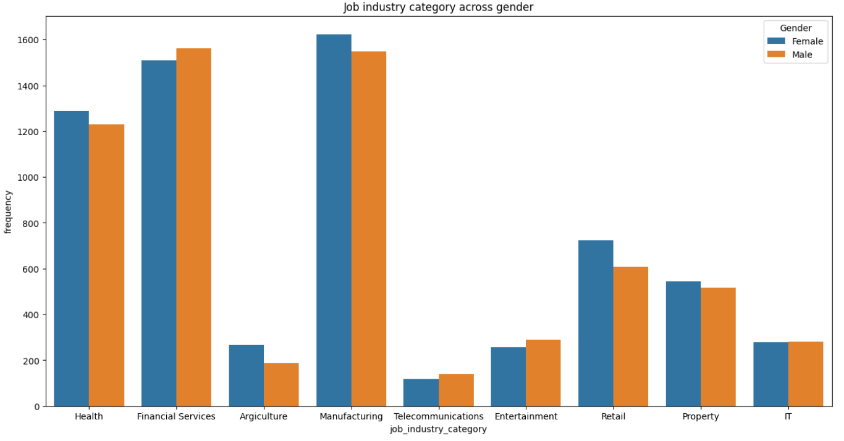
Note: The data and information in this document is reflective of a hypothetical situation and client. This document is to be used for KPMG Virtual Internship purposes only.
Data Exploration
Job category and it’s relationship with gender
Most of the customers job industry are Manufacturing, Financial services and health.
Very less number of customers from Telecommunication and Agriculture industry.
In terms of gender, there is no significant difference between male and female in several job categories.

Slide 7
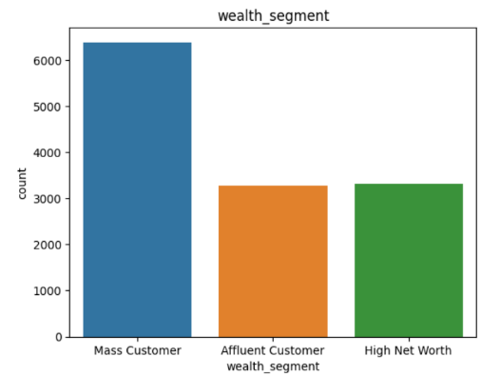
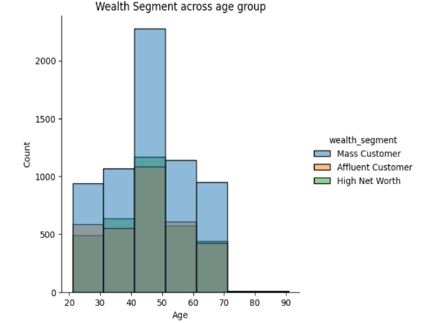
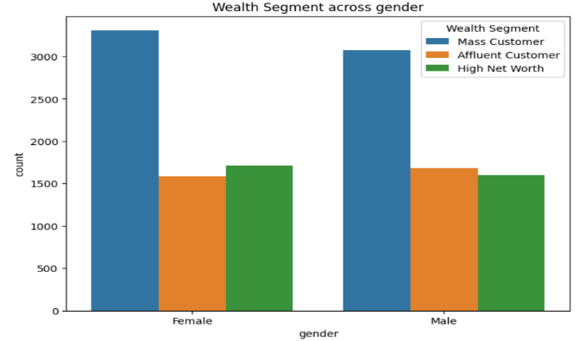
Note: The data and information in this document is reflective of a hypothetical situation and client. This document is to be used for KPMG Virtual Internship purposes only.
Data Exploration
Wealth segment and it’s relationship with gender and age
The mass affluent customers between ages 40-50 show the most purchases.
The mass affluent customer base has the highest number of purchases in the current database compared to the affluent and HNI.
The female customers in the mass affluent has the highest number of purchases in the customer base.

Slide 8
Note: The data and information in this document is reflective of a hypothetical situation and client. This document is to be used for KPMG Virtual Internship purposes only.
Model Development
Recommendation
The company should target age group between 20 and 70 and specifically focus on 40-45 age ranged customers.
They should increase their business in other state along with NSW.
They should initiate special stuffs to attract more high net worth wealth segment customers.
They must work on the Manufacturing, Financial Services, Health, Retail or Property Industry.

Slide 9
Note: The data and information in this document is reflective of a hypothetical situation and client. This document is to be used for KPMG Virtual Internship purposes only.
Interpretation
Place headline insight or information here. This should be the most important point for this slide.
Most of the customer work in the manufacturing, financial services, and health and they have moderate level of wealth i.e. ‘mass customer’ category.
They have customers of all age levels, with a higher concentration of middle-aged customers. Therefore, there product have a correlation with middle-aged group of people.

Slide 10
Note: The data and information in this document is reflective of a hypothetical situation and client. This document is to be used for KPMG Virtual Internship purposes only.
Appendix

Slide 11
Note: The data and information in this document is reflective of a hypothetical situation and client. This document is to be used for KPMG Virtual Internship purposes only.
Appendix
This is an optional slide where you may place any supporting items.

